Slide 1
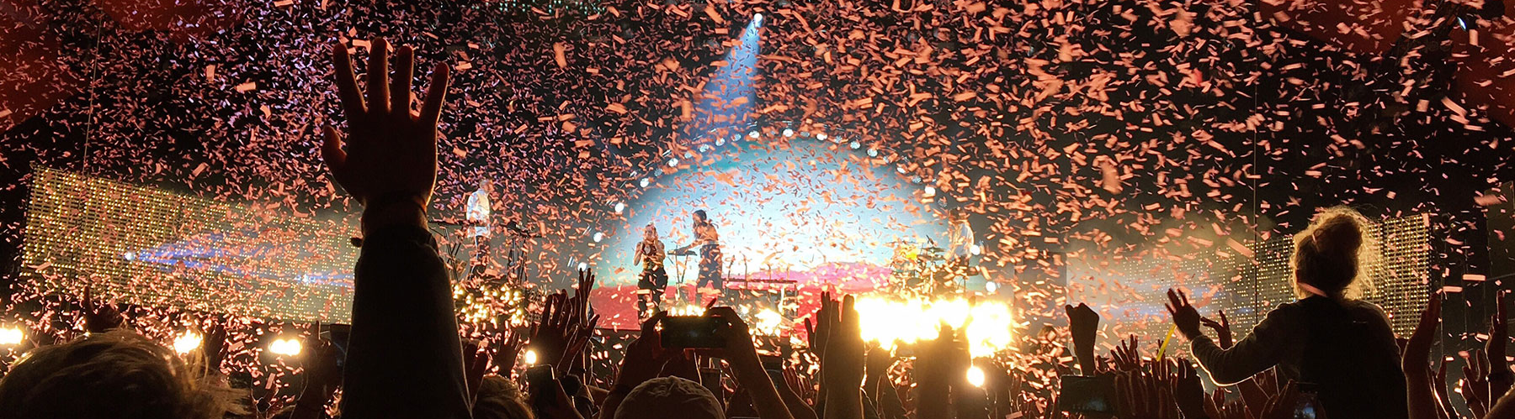
EventDing Official Portal of Northeastern University to host events
Team Members
Kartik - 002788017
Manikanta Reddy – 002704579
Padma - 002727445

Slide 2

Problem Statement
Currently, there is no official channel for students at Northeastern University to view the events schedule and register for it
Students get to know about events on unofficial social media platforms such as Instagram
We come up with a unified solution by making a dedicated portal just for the admin to post events and students to view and book them

Slide 3




Tech Stack We Used
Tech Stack Used
ReactJS, Express, Mongo, NodeJS (MERN Stack)

Slide 4
External APIs/Resources used
EmailJS: To send verification email
Vercel: To host the application's UI
Bcrypt: To safely store user password in database

Slide 5
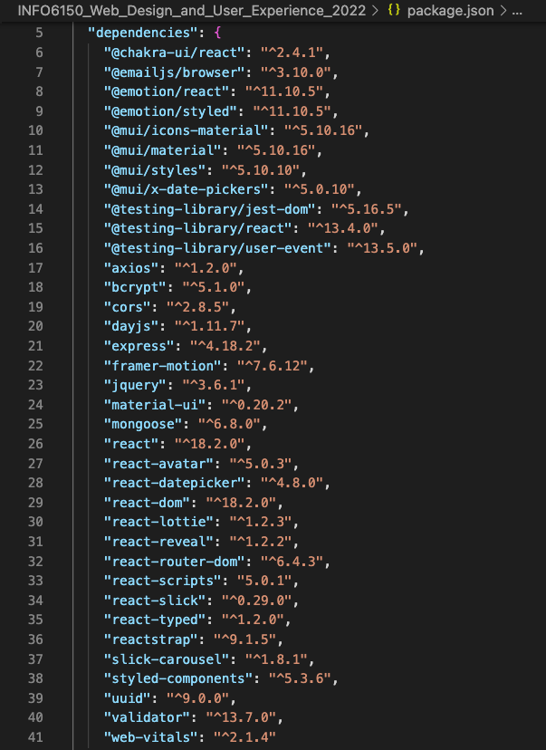
Libraries Used

Slide 6
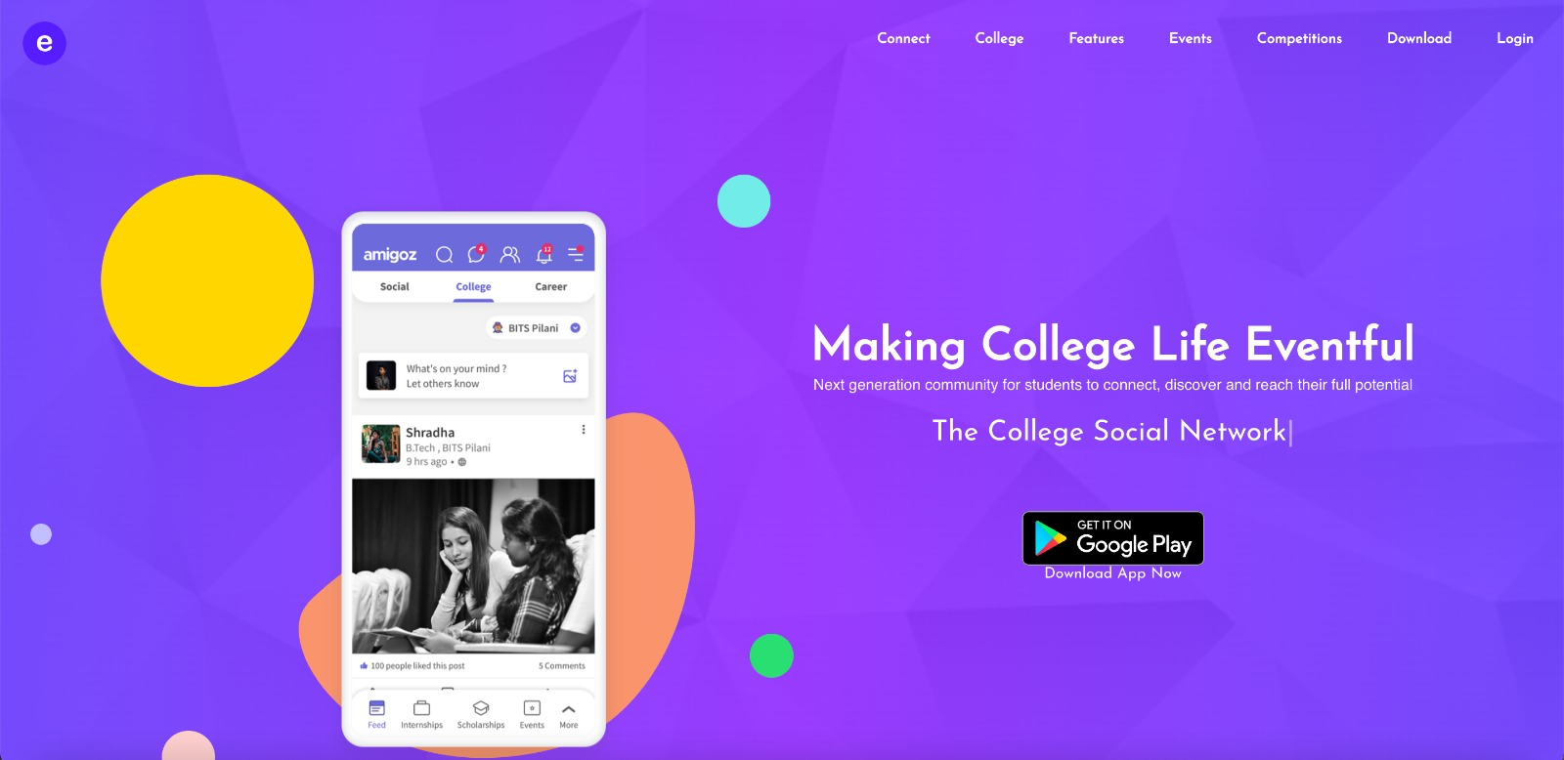
Landing Page

Slide 7
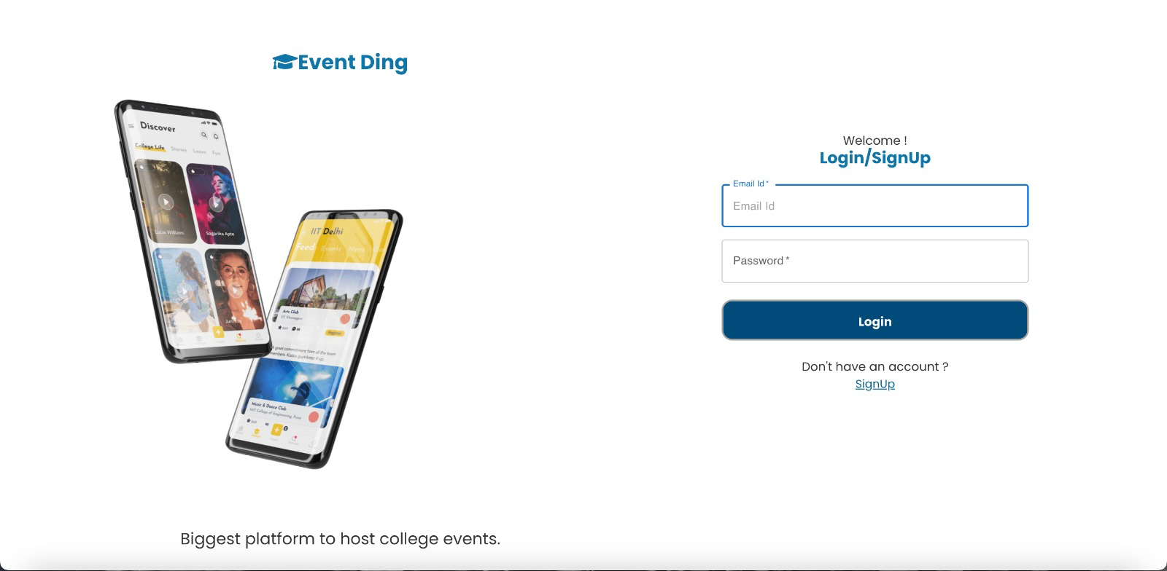
Login Page

Slide 8
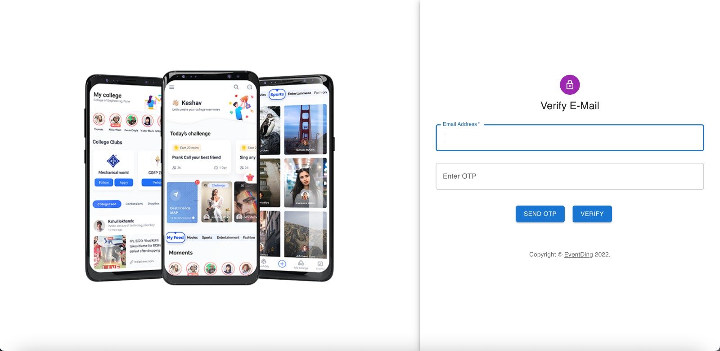
Verify E-Mail

Slide 9
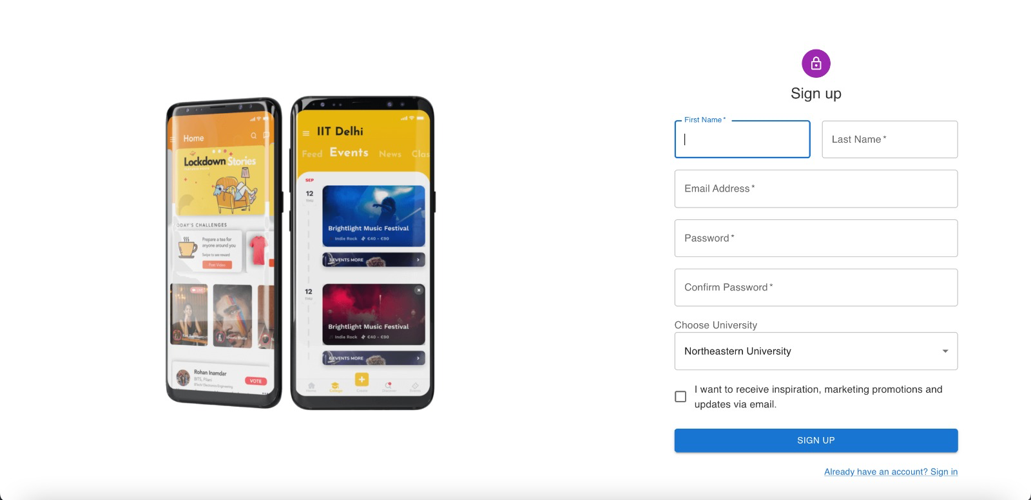
Sign Up Page

Slide 10
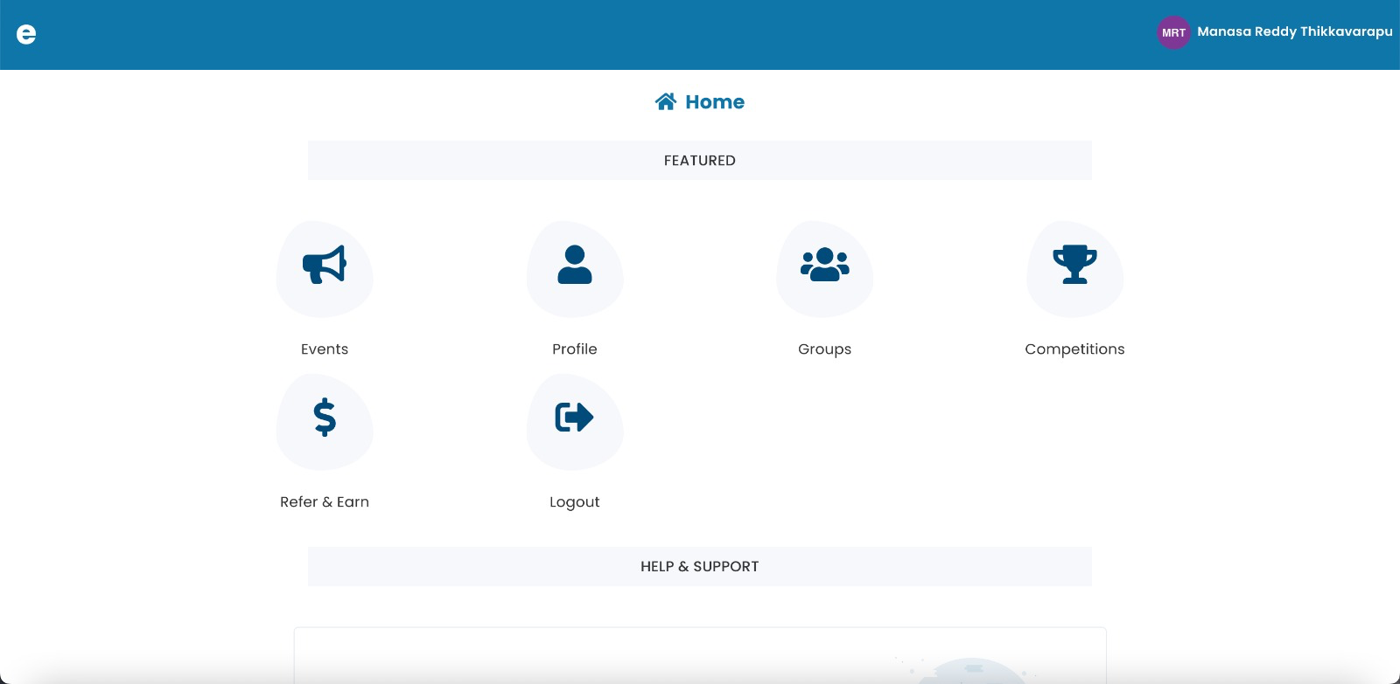
ADMIN HOME

Slide 11
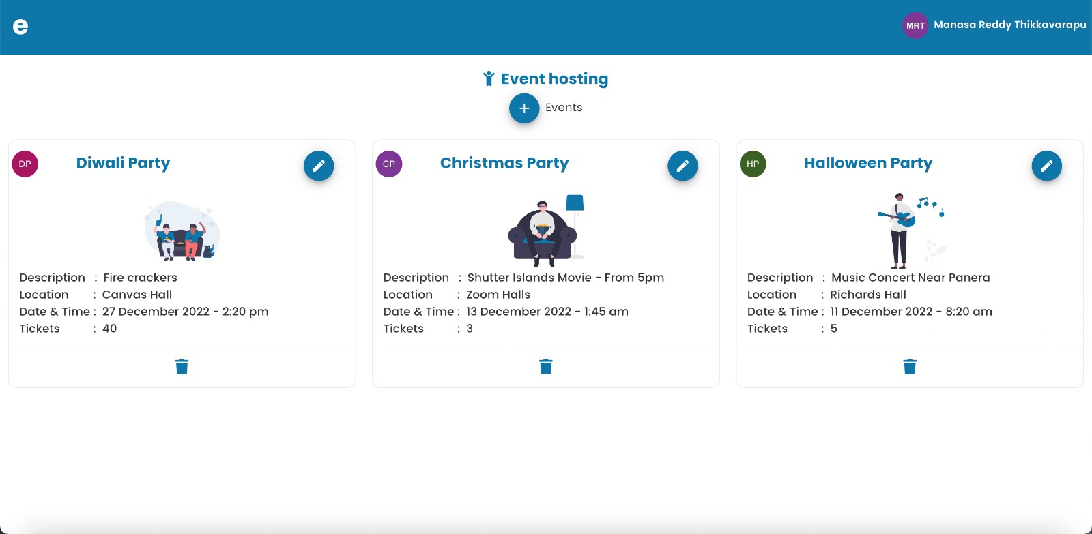
ADMIN HOME PAGE TO ADD/MODIFY/DELETE EVENTS

Slide 12
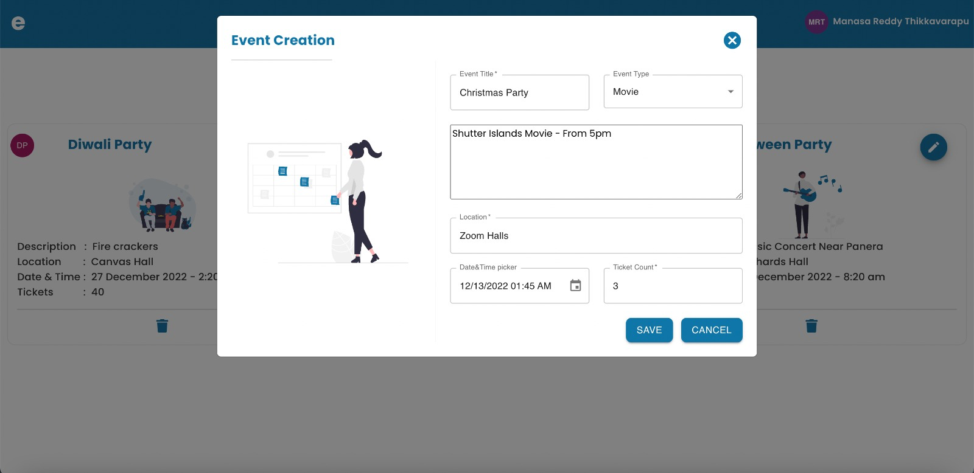
EVENT CREATION FORM

Slide 13
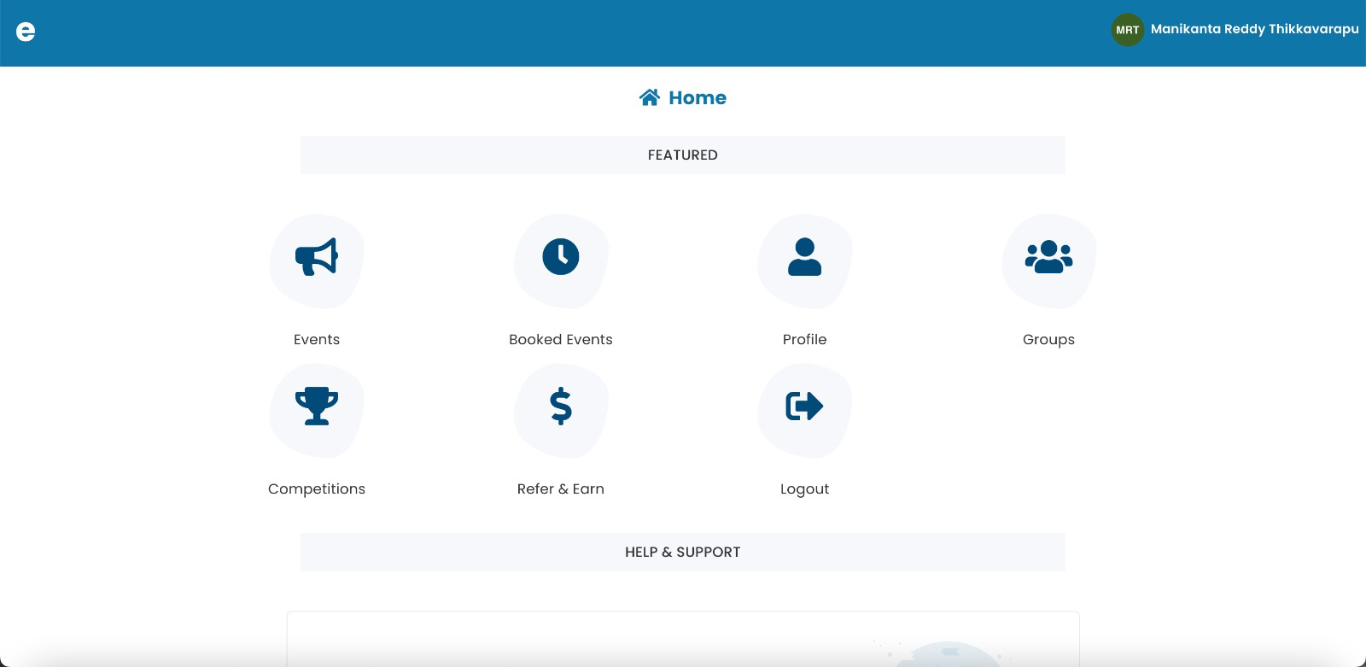
STUDENT HOME PAGE

Slide 14
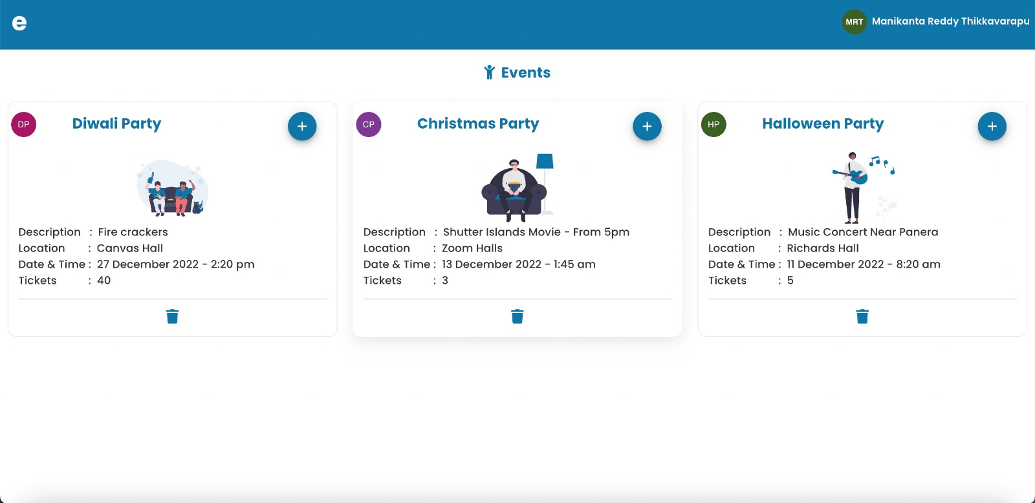
STUDENT EVENTS PAGE

Slide 15
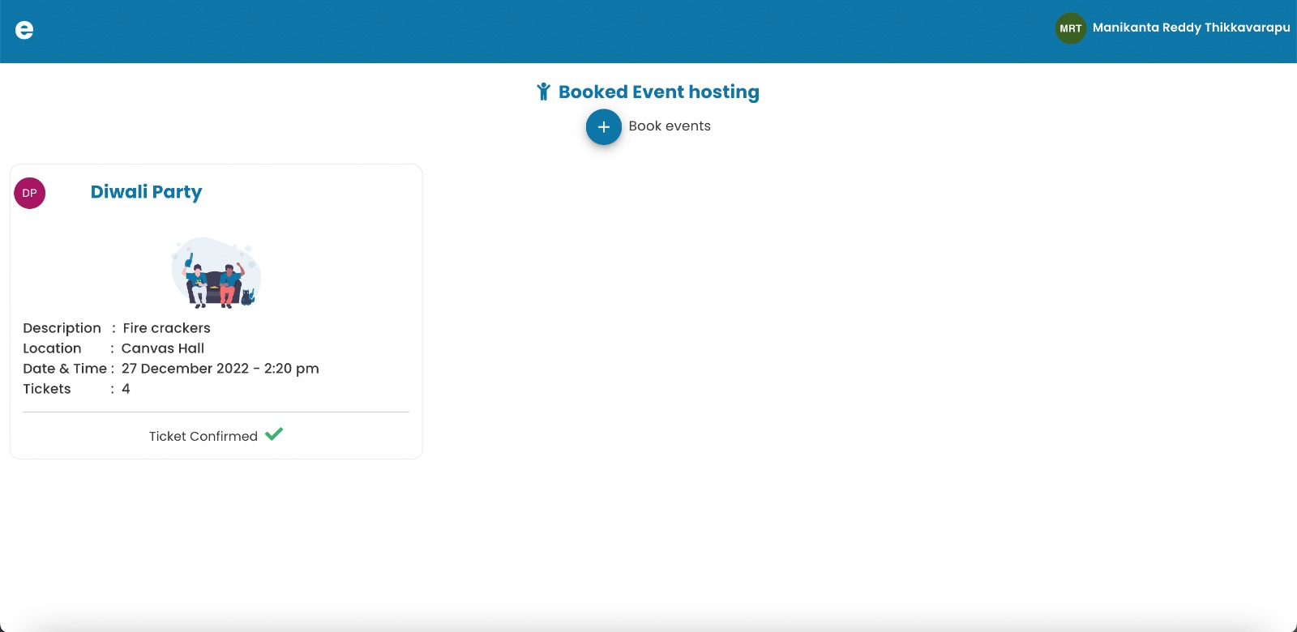
STUDENT BOOKED EVENTS PAGE

Slide 16

QUESTIONS?

